Slide 1
Lecture-1 Chapter-1 Computer Architecture and Organization-Jhon P. Hayes
Computing and Computers

Slide 2
Architecture & Organization
Architecture is those attributes visible to the programmer
Instruction set, number of bits used for data representation, I/O mechanisms, addressing techniques.
e.g. Is there a multiply instruction?
Organization is how features are implemented
Control signals, interfaces, memory technology.
e.g. Is there a hardware multiply unit or is it done by repeated addition?

Slide 3
The Nature of Computing
Throughout history humans have relied mainly on their brains to perform calculation.
The earliest peoples used their fingers, pebbles (stone), or tally sticks for counting purposes.
The early computational aids that were widely used until quite recently are:
- The abacus
- And slide rule.

Slide 4
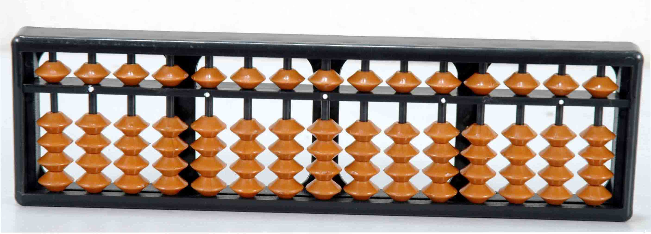
The Nature of Computing
An abacus is a mechanical device used to aid an individual in performing mathematical calculations.
The use of the word abacus dates back to before 1387 when a Middle English work borrowed the word from Latin to describe a sandboard abacus.
Fig: Abacus

Slide 5
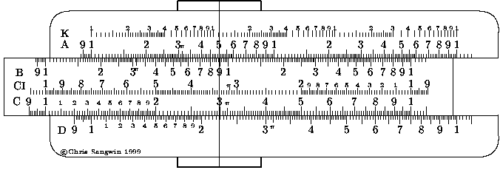
The Nature of Computing
Slide rule
The slide rule, on the other hand, represents numbers by lengths marked on ruler like scales that can be moved relative to one another. By adding a length a on a fixed scale to a length b on a second, sliding scale, their combined length c = a + b can be read off the fixed scale. The slide rule’s main scales are logarithmic so that the process of adding two lengths on these scales effectively multiplies two numbers. It has been in used till 1972.

Slide 6
The Elements of Computers
The brain versus the computer
Consider the actions involved in a manual calculation using pencil and paper. For an example, filling out an income tax return. The purpose of the paper is information storage.
The information stored can include a list of instructions – more formally called a program, algorithm, or procedure – to be followed in carrying out the calculation, as well as the numbers or data to be used.

Slide 7
The Elements of Computers
The brain versus the computer
During the calculation intermediate results and ultimately the final results are recorded on the paper. The data processing takes place in the human brain, which serves as the (central) processor.
The brain performs two distinct functions: a control function that interprets the instructions and ensures that they are performed in the proper sequence and an executive function that performs specific steps such as addition, subtraction, multiplication and division. A pocket calculator often serves as an aid to the brain.

Slide 8
The Elements of Computers
A computer has several key components that roughly correspond to those just mentioned, which are:
Main Memory
CPU
PCU
ALU
Input/Output

Slide 9
The Elements of Computers
Main memory
corresponds to the paper used in the manual calculation. Its purpose is to store instructions and data.
CPU (Central Processing Unit)
ALU (Arithmetic Logic Unit
is consider as the brain of a computer. It contains a program control unit (also known as an instruction unit) whose function is to fetch instructions from memory and interpret them.
which is a part of CPU’s data processing or execution unit, carries out the instructions.

Slide 10
That’s All Thank You

